Slide 1
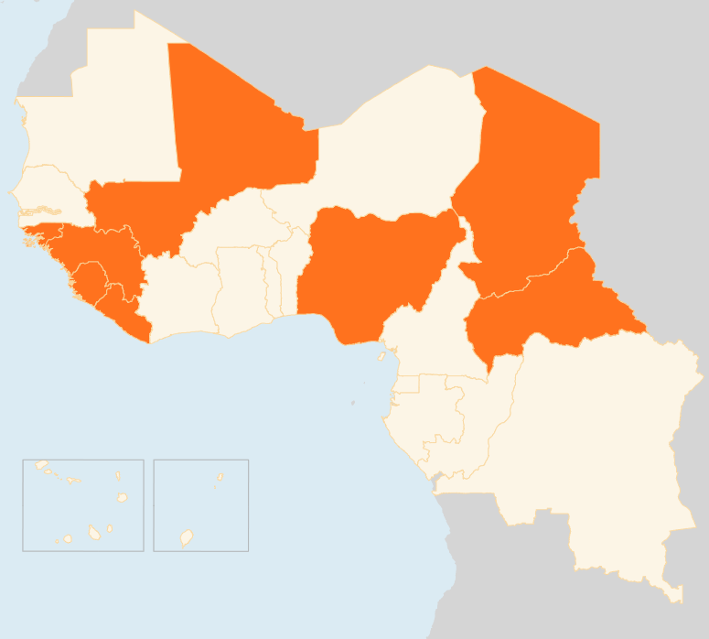

18 – 24 August 2015
CENTRAL AFRICAN REPUBLIC (CAR)
humanitarian workers attacked in Bambari
On 20 August, a vehicle with humanitarian workers was attacked in Bambari and one staff injured. The vehicle was on its way to retrieve casualties from the clashes in Bornou neighbourhood, when a mob intercepted and attacked its occupants. Renewed intercommunal tensions in Bambari have resulted in 10 civilians dead and 8 injured. The situation on the ground remains very tense and all humanitarian activities in Bambari have been temporarily suspended pending a reassessment of the security of the operating environment.
CHAD
7 new spontaneous IDP sites IN the Lake region
Over the last week, seven new sites hosting internally displaced people were reported in the Lake region, bringing the total number of IDP sites to 22. Between 21 July and 21 August, at least 41,000 people had already been displaced. The additional number of IDPs in the seven new sites remains unknown, as evaluations have not yet been carried out. Most important needs include shelters, food security, WASH, and health.
GUINEA
Political parties sign deal
On 20 August, the ruling party and opposition coalition signed a political agreement towards ending political tensions. Local elections were planned for 2014 but have been postponed due to the Ebola epidemic. The opposition parties claim that the Presidential elections, which are due to be held on 11 October, should not be held before the local ones without consultation.
GUINEA-BISSAU
NEW PRIME MINISTER CONTESTED BY PARLIAMENT
The political crisis in Guinea-Bissau continues, whilst no further protests were reported in the past week. The appointment of a new Prime Minister was condemned by the Parliament because he was not put forward by the party which won the last legislative elections. The UN expressed concerns that the crisis risks to undermine progress and destabilize the political situation.
MALI
Key rebel group suspend peace agreement MONITORING
The Coordination of Azawad Movements (CMA) announced that they will suspend their participation in a committee monitoring the peace agreement. The agreement was signed in June 2015 by the Government and rebel groups to end the conflict in northern Mali but there has been a recent spike in violence.
NIGERIA
U.N. Secretary-General Ban Ki-moon visit
On 23 August, Ban Ki-moon began a two-day visit to Nigeria. After meeting with President Buhari, he pledged support for Nigeria's efforts to counter Boko Haram and tackle the causes of militancy in the country's northeast, where he described humanitarian conditions as particularly worrying.
EVD REGIONAL
Ebola still in Guinea, zero cases in Liberia and Sierra Leone
The number of cases of Ebola in Liberia and Sierra Leone remains at zero, while this week reported three new cases in Guinea. Presently, six EVD patients are receiving treatment in Guinea and several more suspected cases. All new cases for the past month are from known chains of transmission, permitting easier case management and tracking.
GUINEA-BISSAU
POLITICAL CRISIS CONTINUES
MALI
REBELS SUSPEND PEACE AGREEMENT
MONITORING
CHAD
7
NEW IDP SITES
IN LAKE REGION
NIGERIA
UN SG PLEDGES SUPPORT
CAR
HUMANITARIANS ATTACKED IN BAMBARI
EVD REGIONAL
3
CASES IN GUINEA
0
IN SIERRA LEONE AND LIBERIA
Creation date: 25 August 2015
Map data sources: UNCS, DevInfo, OCHA.
The boundaries and names shown and the designations used on this map do not imply official endorsement or acceptance by the United Nations

